Slide 1
Clearfield (PA) Conveyance System Modeling and Monitoring Project
PennTec 2014
State College, PA
June 3, 2014
Presented By:
Gwin, Dobson & Foreman, Inc.
Altoona, PA

Slide 2
Presentation Outline
Inflow/Infiltration Source Removal, Convey /Treat or Both?
Clearfield Case Study
System Description – Overflow Problems
Original I/I Removal Project – Replace Total System
DEP Consent Order & Agreement
Post Construction Monitoring & Modeling
Treatment & Conveyance System Upgrades
Observations/Lessons Learned
Questions

Slide 3
Important Questions…
For systems with high wet weather flows, is the best strategy…
I/I source removal?
I/I conveyance and treatment?
or combination of the above?
Most systems have some level of inflow and infiltration
True sanitary sewer systems – designed to carry only sanitary waste – bypass or discharges are considered SSOs
Combined systems – designed to carry both sanitary and stormwater – bypasses or discharges are designated CSOs – confined to systems 50 – 100+ years old
SSO and CSO abatement is a regulatory priority

Slide 4
Important Questions…
System owners and engineers often face the dilemma of removing or treating I/I
This presentation will discuss lessons learned and options to consider when faced with similar situations
Clearfield system will be presented to offer practical problems and insights

Slide 5
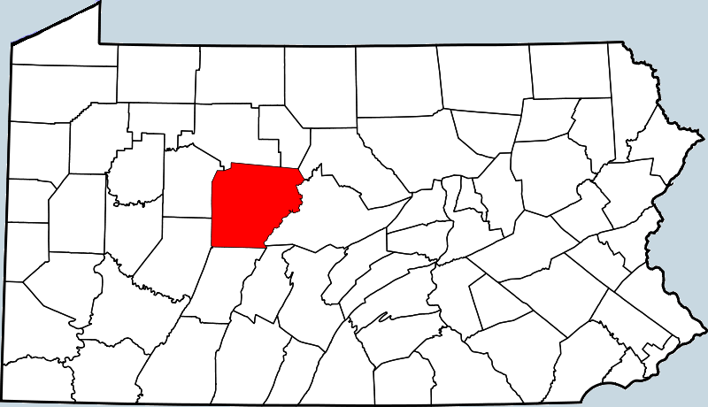
Clearfield Case Study
Clearfield Municipal Authority (CMA)
Service Area – 6,000 connections in Clearfield Boro & Lawrence Twp
Authority owns interceptor sewers network, pump stations and regional treatment facility
Borough and Township own their respective collection systems
Older portion designed as combined sewer system with CSO’s
CMA under Consent Order & Agreement to eliminate overflows
CMA required to provide Biological Nutrient Removal
Clearfield, PA

Slide 6
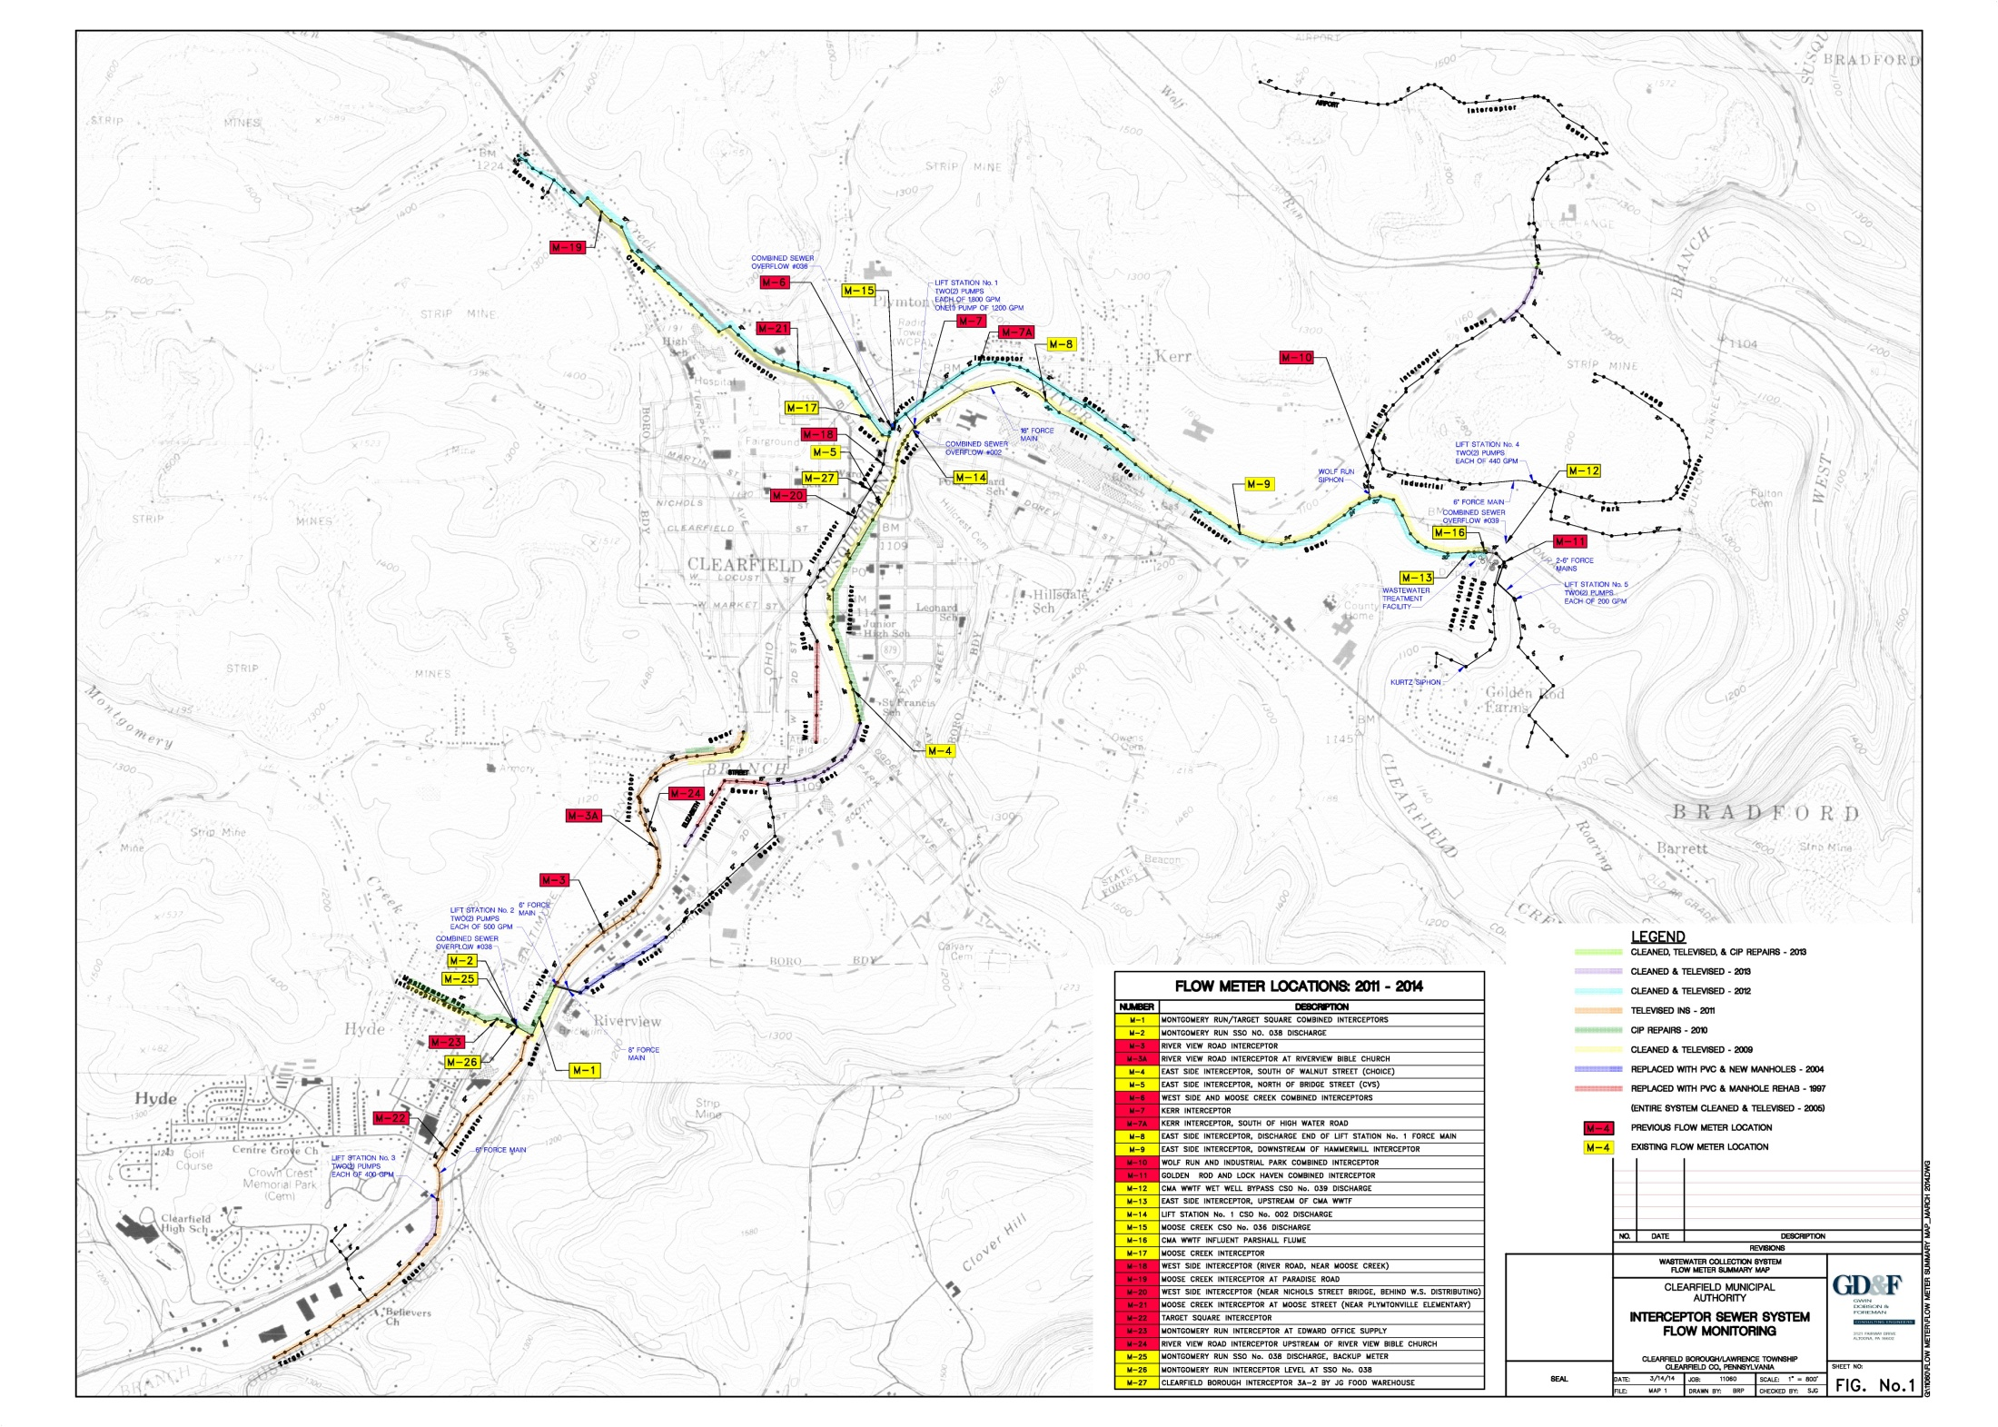
US Rt 322
Lift Sta. No. 1
Rt 879
Overflow
Lawrence
Township
I-80
Clearfield
Borough
Lawrence
Township
Overflow
Wastewater Treatment Facility with Overflow
US Rt 322
Overflow
Lift Sta. No. 2
Lawrence
Township
Rt 879

Slide 7
Sewer System Description
Total System - 341,000 LF (65 miles), 6,000 Customers
Allocated by System Ownership:
Clearfield Municipal Authority
85,300 LF (16.5 miles) - interceptor sewers and force mains (25%)
Five (5) lift stations
One (1) SSO and three (3) CSOs
Regional wastewater treatment facility
Clearfield Borough
148,000 LF (28 miles) - sewage collection system (43%)
Lawrence Township
107,000 LF (20.5 miles) – sewage collection system (32%)

Slide 8
System Overflows
In 2004, CMA system maintained 10 overflows
6 overflows have since been closed
4 remaining overflows are manually activated during wet weather events to prevent system surcharging and backups
Overflows consist of a combination of SSO’s in Lawrence Township and CSO’s in Clearfield Borough

Slide 9
Historical Background
Regulatory action forced the community to develop an Act 537 wastewater management plan to eliminate overflows in 1995
Decision makers were faced with either removing I/I to eliminate overflows or expand treatment plant & conveyance system
Municipalities decided to entirely replace sewer system and laterals; the Clearfield Municipal Authority expressed reservations with the plan advocating conveyance/treatment
Clearfield Borough spent $30M to replace all sewers & Lawrence Township invested over $10M (thus far) to replace most sewers
Clearfield Municipal Authority faced with a WWTF expansion & BNR Upgrade and possible conveyance system project ($40 M)

Slide 10
Municipal Sewer Replacement Project
From 2001 to 2011, Borough and Township’s projects replaced all main line sewers and the majority of private laterals back to the house foundation
Project only replaced private laterals when property owners agreed to sign easements
System inspection of houses for illegal connections was sporadic after construction
Although infiltration was reduced, peak flows in the system still cause overflows which collectively would far exceed capacity of the treatment plant
In 2013, PADEP issued a Consent Order & Agreement to remove overflows since sewer project was not successful
Authority must now expand plant for peak flow and plan for interceptor upgrades if I/I is not removed

Slide 11
CMA Flow Monitoring Program Elements
Do quantify problem severity, CMA & GDF designed a monitoring program to isolate problem areas and a basis for model calibration
Accurate flow data is critical to prioritize corrective action & structural improvements
Sufficient period of record is needed - monitoring must be conducted at numerous locations for long periods of time to capture wet weather events
Flow meter programmed designed for different hydraulic conditions (surcharge, free flow, reverse flow)
Continuous meter maintenance and weekly data collection
Commitment of budget resources for flow monitoring program is a must; many tasks done by CMA personnel

Slide 12
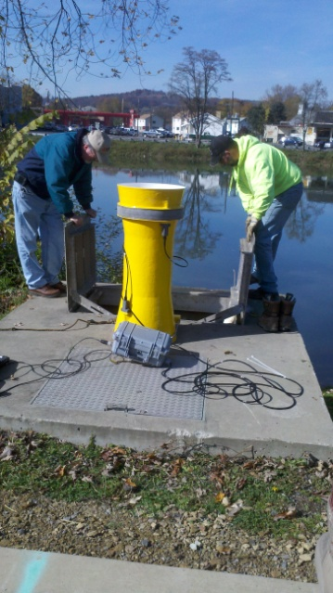
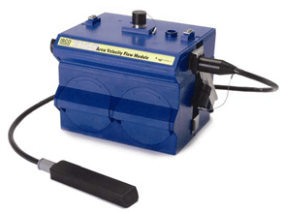
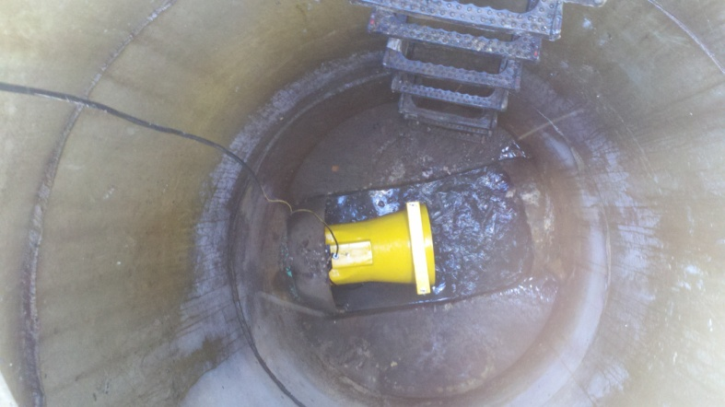
Flow Monitoring Devices
Initial program monitored flows at sixteen (16) strategic locations in the main conveyance lines and CSOs/SSOs
Total of twenty-seven (27) flow monitoring locations from 2011 to 2014
Combination of area-velocity and
flow-tube flow meters

Slide 13
Flow Monitoring Devices
Area-Velocity Meters
Continuous wave Doppler technology measures average velocity
7 meters installed in non-surcharged areas
Primarily used in areas not prone to surcharge conditions
Flow-Tube Meters
Transducers estimate flow through pressure differential in the upstream and downstream sections of the meter
3 meters installed in frequently surcharge areas (pressure pipe flow) and in submerged overflow pipes with the potential for reverse flow

Slide 14
Flow Monitoring Data Collection
Authority personnel trained on proper operation and maintenance of flow meters
Weekly downloads of flow meter data
User friendly interface for quick and efficient data retrieval. Ability to view real-time flow data and identify any real-time problems and make adjustments
Engineer oversight with Authority for first six (6) months of flow study (November 2011 to May 2012)
From May 2012, Authority maintains flow meters and downloads and submits data to Engineer for analysis

Slide 15
WWTF Flow Monitoring Devices
Existing WWTF flow meters
WWTF influent low meter: Parshall flume
WWTF bypass: weir with ultrasonic level transducer
Both meters record continuous flows on chart recorders at the treatment facility
Rainfall data recorded and compared with flow data to develop peak flow and total volumes trends relative to precipitation intensity
Significant precipitation events >0.50 inches in 24-hours
Major precipitation events resulted from >1.00 inches in 24-hour period or events with high precipitation intensity, i.e.. > 0.50 inches/hour

Slide 16
Flow Monitoring
Interceptor sewers are monitored to quantify subsystem dry weather baseline and wet weather flow
Peak wet weather flows range up to 25 times dry weather flow indicative of significant I/I problems
Example: Hyde City Lift Station No. 2 (1.50 MGD capacity).
Normal ADF : 0.29 MGD (separate sanitary sewer system)
Peak wet weather loading > 3.0 MGD
To prevent flooding of pump station, flow is diverted to Montgomery Run SSO
Raw wastewater effluent bypassed to Montgomery Run after course bar screening for solids
DEP fines are assessed on per calendar day of overflow volume

Slide 17
Flow Monitoring Results (Post Construction)
WWTF Plant Capacity: 4.5 MGD
WWTF ADF: 2.2 MGD
Peak Wet Weather Hourly Flow: 15 MGD
Infiltration reduced by 0.5 MGD
Overflows still occur 10-20 times per year
Sanitary sewer subsystem at Hyde City regularly discharges in excess 2.5 MGD

Slide 18
Flow Monitoring Summary (2011-2014)
Flow Monitoring 2011 –2014
Total 54 significant precipitation events
Peak event precipitation: 2.78 inches in 91 hours (0.40 inches/hour max hourly precipitation)
Max hourly precipitation during an event: 0.77 inches/hour
30 of 54 metered events caused CSO/SSO overflows
Peak event CSO/SSO discharge volume: 12.5 million gallons
Peak CSO/SSO discharge rate: 6.4 MGD
Peak hourly total flow: 15 MGD
24 events with peak hourly flow greater than 7 MGD
15 events with peak hourly flow 10 MGD or greater
CSO/SSO Events Summary Table
Year | Annual Rainfall | No. of Metered Significant Precipitation Events | No. of CSO/SSO Events | Annual CSO/SSO Volume | Max. Daily CSO/SSO Flow
 | (inches) |  |  | (MG) | (MGD)
2011 | 51.26 | 5 | 18 | 110 | 6.4
2012 | 34.78 | 19 | 12 | 32 | 5.6
2013 | 31.77 | 22 | 10 | 24 | 5.1
2014 (to date)* | 14.7* | 8 | 7* | 7* | 6.0*

Slide 20
Conveyance System Modeling
Model Developed to Confirm Surcharged Locations and for Capacity Design of Future Conveyance System
Bentley SewerGEMS V8i Software Package
Facility Components
Gravity interceptors
Submerged outfalls
Pump stations
Force mains
Overflows
Inverted siphons

Slide 21
Model Input
Model created from a compilation of as-built drawings and field instrument surveys
Physical Data
Pipe materials, lengths, diameters, invert elevations
Manhole diameters, invert and rim elevations, locations
Pump station wet well elevations and volumes, pump set-point controls, certified pump discharge curves, pump elevations and pump station mechanical piping and force main
Siphon box invert and rim elevations, siphon barrel materials, lengths, lengths, elevations
Overflow configurations

Slide 22
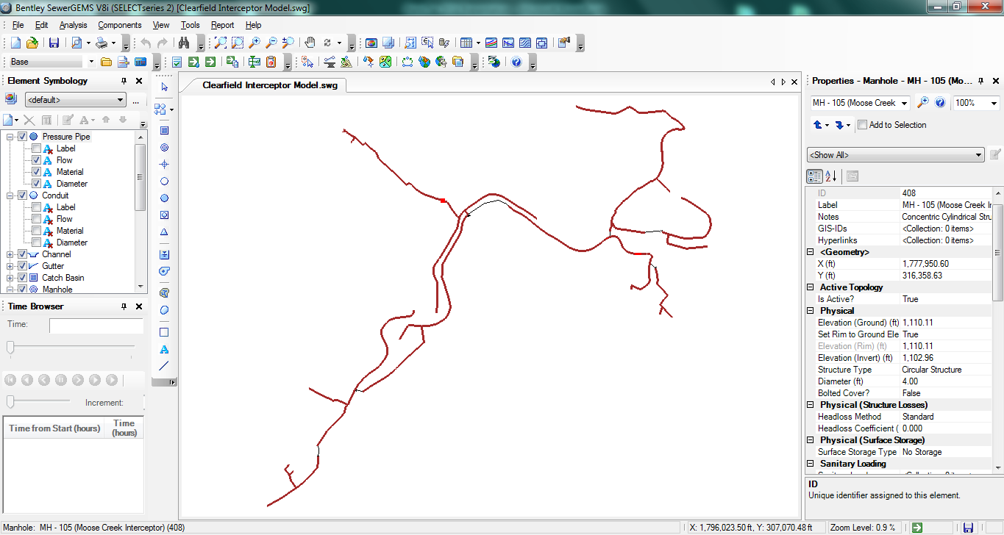
Model Input Graphics

Slide 23
Model Calibration
Model calibrated with flow monitoring data during baseline conditions and wet weather events
Hydraulic grade line elevations computed from model were compared with actual flow metering levels for various flow rates throughout the system
Adjustments to the model were made to achieve a tolerance of one to two inches between the differences in HGL between the model output and calibration data

Slide 24
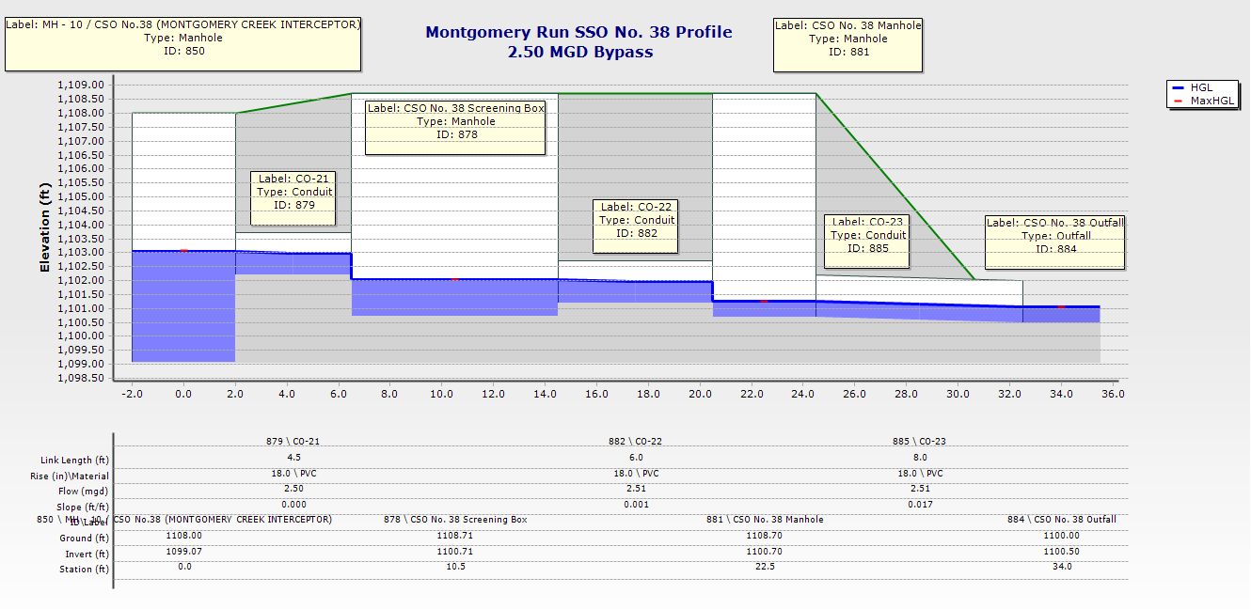
Model Output and Graphics

Slide 25
Consequences of Sewer Surcharging
Majority of main interceptors have insufficient capacity to convey peak flows without surcharging
Model confirmed that peak flows are greater than gravity flow conveyance capacities at overflows
Surcharging of sewer lines is not permitted by DEP
Frequent surcharging of sewer lines results in pipe failure and decreases its effective life span
Surcharging of main lines may result in backups in private laterals
The overflows are designated SSO violations since all combined sewers have been separated

Slide 26
Design of Future Conveyance System
If ongoing municipal I/I reduction is unsuccessful, CMA mandated to increase capacity of interceptors, lift stations and force mains
Model was used to design a new main 42” diameter gravity interceptor to the WWTF
New interceptor sized to convey a future peak flow of 25 MGD to the treatment facility to eliminate all overflows from the system (assuming future I/I is unsuccessful)
Other future conveyance system upgrades will be programmed to convey all flow to the treatment plant

Slide 27
Inflow/Infiltration Sources
Wet weather flows results from ongoing customer connection inflow not removed in the original project and ongoing municipal cross-connections
Roof leaders
French drains
Sump pumps
Cross connections

Slide 28
Ongoing System Infiltration/Inflow Work
DEP has issued a CO&A with fines for SSO discharges
The municipalities are now undertaking an aggressive private lateral and home inspection program
Outside inspection agency hired to conduct the home inspections
However, long term I/I reduction is questionable due to meager municipal resources

Slide 29
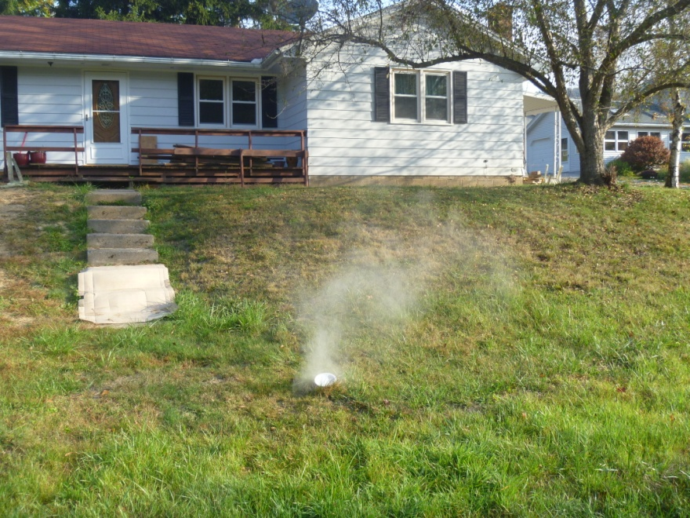
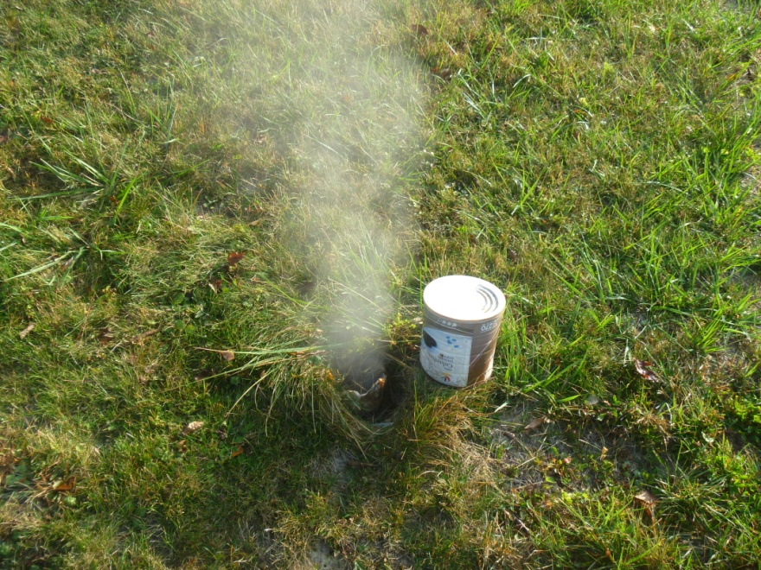
Private System Inspections
House connections (laterals and building sewers) must be the focus
House connections and laterals can account for 40% - 8% of total system wet weather flow (WEF

Slide 30
House Inspections
Need to inspect for:
Storm, surface, groundwater and spring connections
Roof, foundation and floor drains
Sump pumps
Industrial/commercial process water
Public support is beneficial:
Newspaper articles to explain program in detail
Project Manager s should have good communication & “people” skills
Respect for homeowners and private property
System rules & regulations, municipal ordinance support and associated fines a must for proper enforcement
Tracking & follow-up inspections needed for compliance
No exceptions – stay firm and treat everyone equally
Public sewer system must also have I/I integrity

Slide 31
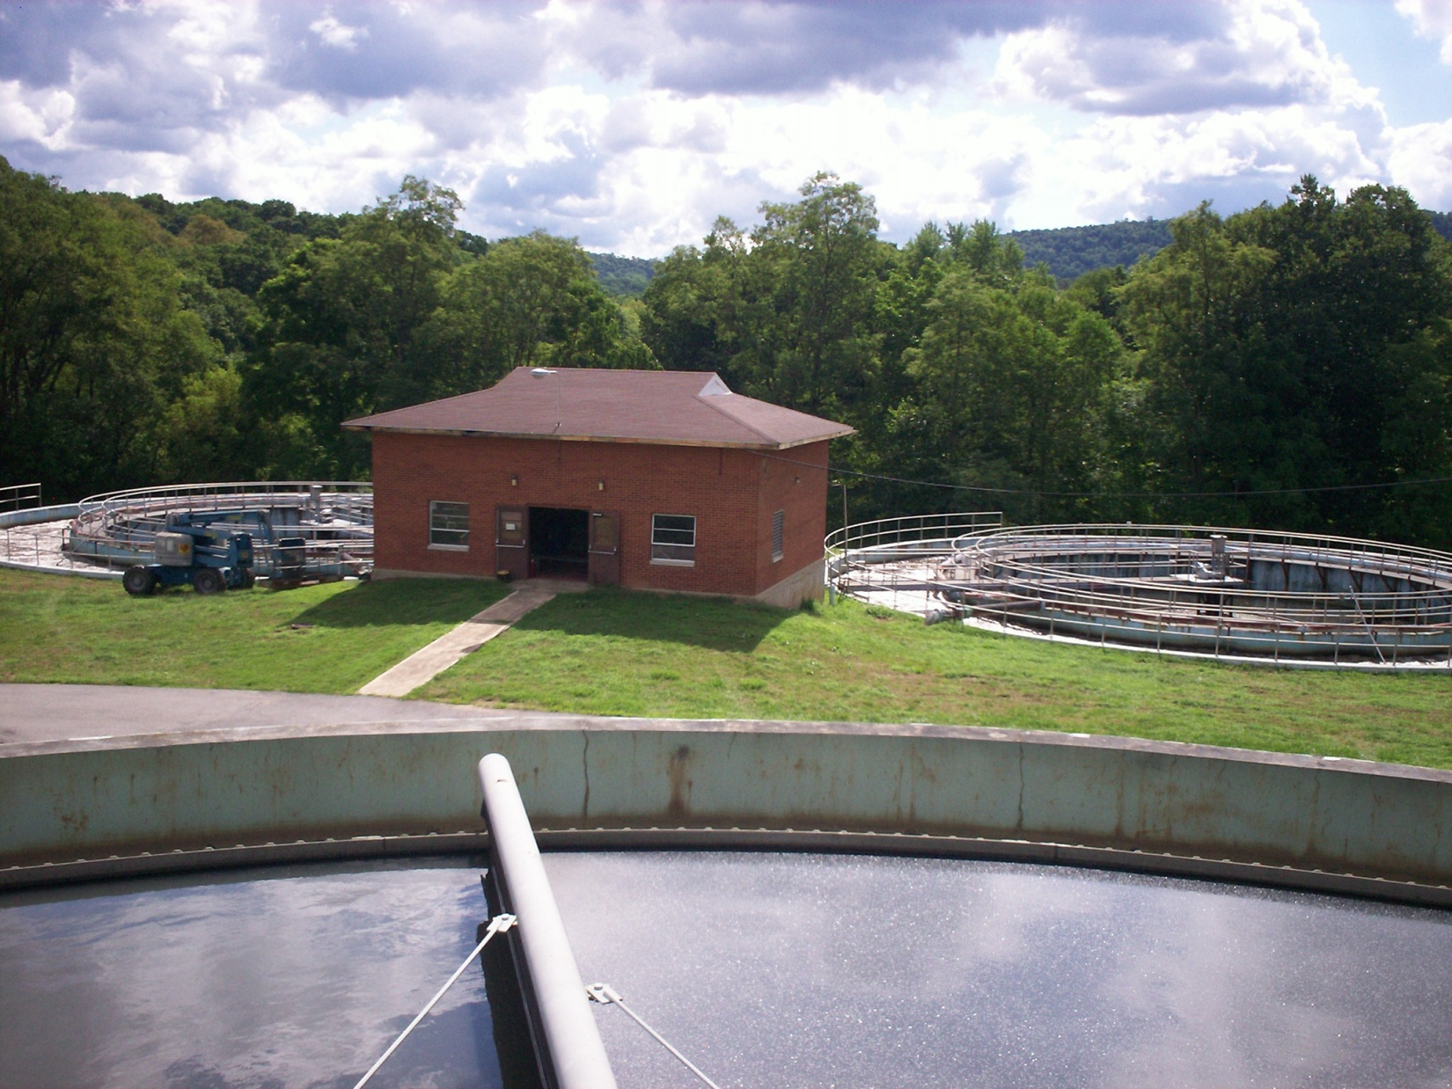
Wastewater Treatment Facility Upgrades

Slide 32
Wet Weather Options
Historically, wet weather flows in larger, older systems are handled in several ways:
Bypass wet weather flows in conveyance system upstream of plant
Combined systems are required to maximize conveyance and treatment in LTCP (Nine Minimum Controls)
Equalization storage at conveyance system or plant
Side stream treatment with disinfection only, if allowable
Depending on process requirements, some plants are capable of treating the full range of flows directly in the process – this was examined for Clearfield plant upgrade

Slide 33
Wastewater Treatment Facility Upgrades
Originally built in 1958, the Clearfield wastewater treatment plant is to be upgraded for nutrient removal and expanded to 25 MGD for system wet weather flow
Process treatment system will utilize a step-feed system to divert wet weather flow around BNR process
Although replacement projects have been unsuccessful in reducing peak wet weather flows, the Township and Borough are obligated to remove I/I per Consent Order & Agreement
If Township/Borough I/I efforts fail, further conveyance system work may be needed (including pump station, force main, interceptors) that could total $1 million

Slide 34
Conveyance Work if I/I Removal is Unsuccessful
Upgrade main pump station, force main and gravity interceptor to the WWTF to provide conveyance capacity for the wet weather flows
Following the completion of the project, the Authority will be able to close the SSOs
Total cost for the WWTF improvements is $35M with wet weather upgrade options estimated at $5M.

Slide 35
Clearfield Wastewater Treatment Facility Upgrade & Expansion

Slide 36
Evaluation of Treatment Alternatives
Conducted extensive wastewater characterization influent wastewater over full range of flows
Evaluated existing treatment processes and conducted preliminary screening of various Nutrient Removal Technologies (NRT)
Dynamic process modeling (BioWin) of various NRT processes, simulated wet weather flows for impact
Selected Hybrid Bardenpho with Virginia Initiative Plant option for cold, wet weather flows
Step feed diluted wet weather flow to last oxic zone to provide secondary (contact stabilization) treatment

Slide 37
Selected Wet Weather Process - Step Feed
Diverts wet weather flow to the last process oxic zone
Provides biological treatment of all diluted wet weather by contact stabilization (1-2 hour detention)
Preserves BNR process stream (Virginia Initiative Plant process configuration used in cold, wet weather periods)
Preserves nitrifiers and denitrifiers to maintain nitrogen and phosphorus removal during and after high flow events
Prevents elevated DO concentrations in BRN process
More importantly, prevents biomass washout that would otherwise take BNR process weeks to recover.

Slide 38
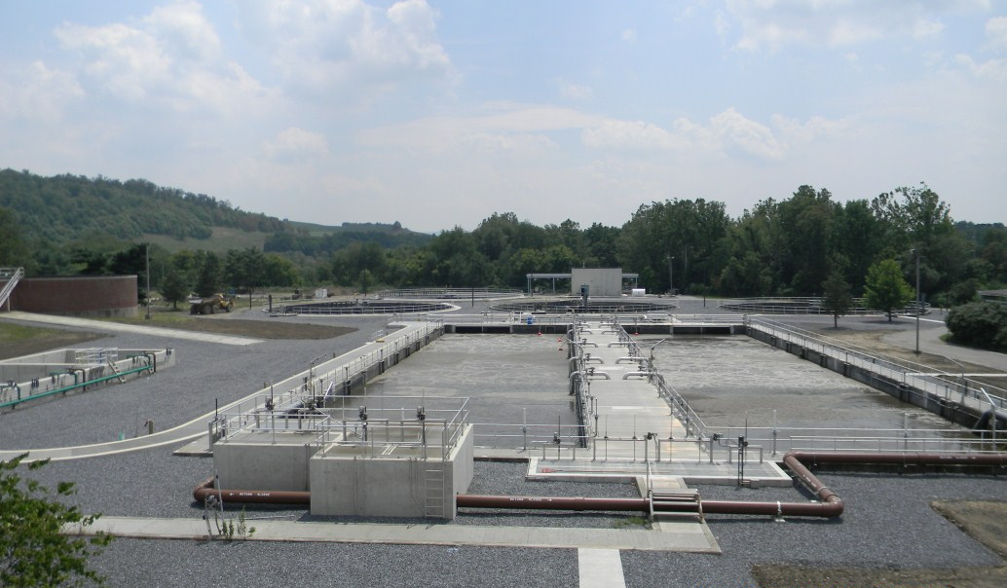
BNR Process with Wet-Weather Step-Feed
Step Feed Discharge to Last Oxic Reactor Zone
Final Clarifiers (3)
Step Feed Channel
BNR Process Reactor
BNR Process Reactor
BNR Process Flow Distribution Box

Slide 39
Clearfield Case Study - Lessons Learned
Original municipal plan to eliminate overflows was for total sewer system replacement
The project was not successful since overflows are ongoing (10-20/year) due to inadequate inspection of house laterals & direct connections
This has resulted in a DEP Consent Order & Agreement and municipalities must undertake further I/I removal through selected projects and house inspections
Failure to eliminate overflows will result in the Clearfield Municipal Authority upgrading pump stations, force mains and interceptors
Ongoing treatment plant work has provision for processing current peak system flow that is incorporated in a BNR process through step-feed
The Authority believes unnecessary costs were incurred when conveyance, treatment and selective I/I diagnostic work would have achieved the same result for less money

Slide 40
Clearfield Case Study - Lessons Learned
For new systems with surcharging or overflows, I/I removal may be the best option especially when Peak to ADF ratio is less than 5 : 1
However, flow monitoring and I/I diagnostic work is essential to define subarea contributions and facilitate flow isolation
In older systems, communities with dwindling resources for maintenance personnel and equipment may be inadequate for long term I/I control
Total system replacement does not address inflow adequately unless ongoing house inspections and I/I diagnostic work is a long term commitment – difficult for older “cash strapped” communities
In larger older systems, a mix of treatment and conveyance system expansion with targeted I/I removal may be the best option
To incorporate wet-weather flow (> 5 : 1 Peak to ADF in a BNR process, consider a step-feed option in the plant design

Slide 41
Questions

